Slide 1

Ma Pensine
CM

Slide 2
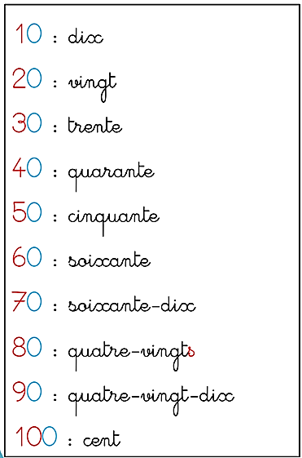
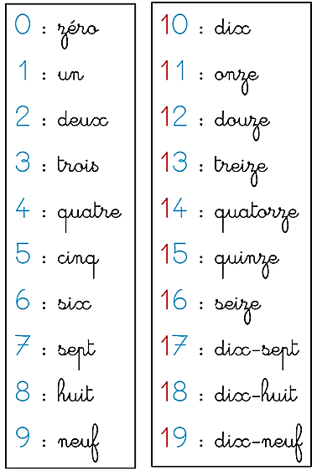
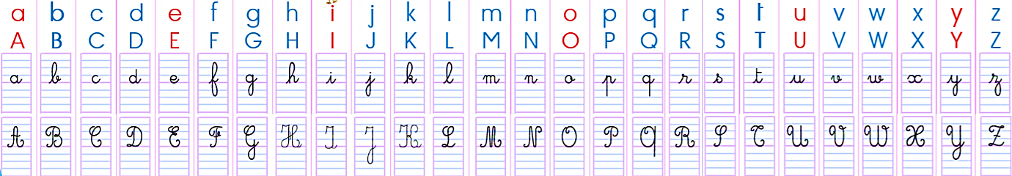
ECRIRE LES NOMBRES
L alphabet
1000 : mille

Slide 3
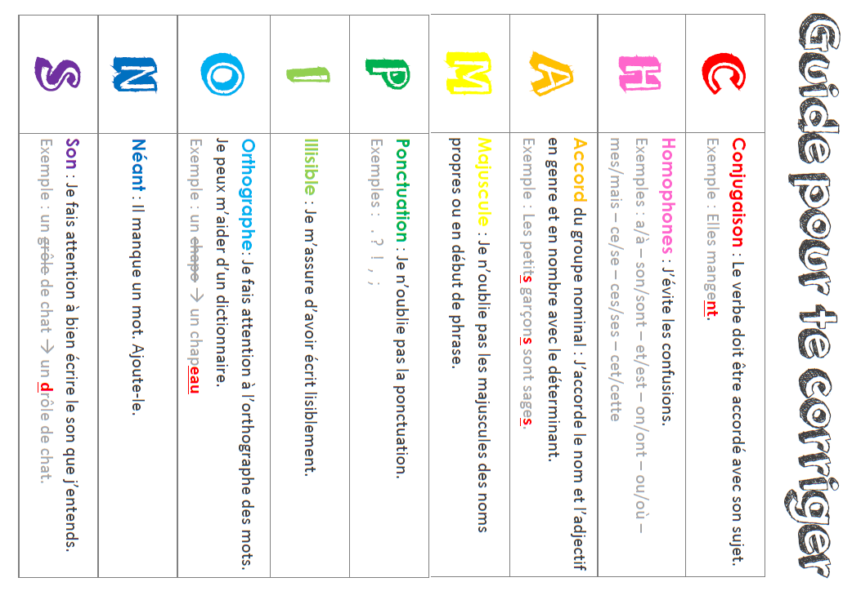
https://www.classeetgrimaces.fr/guide-pour-se-corriger-le-code-champions/

Slide 4


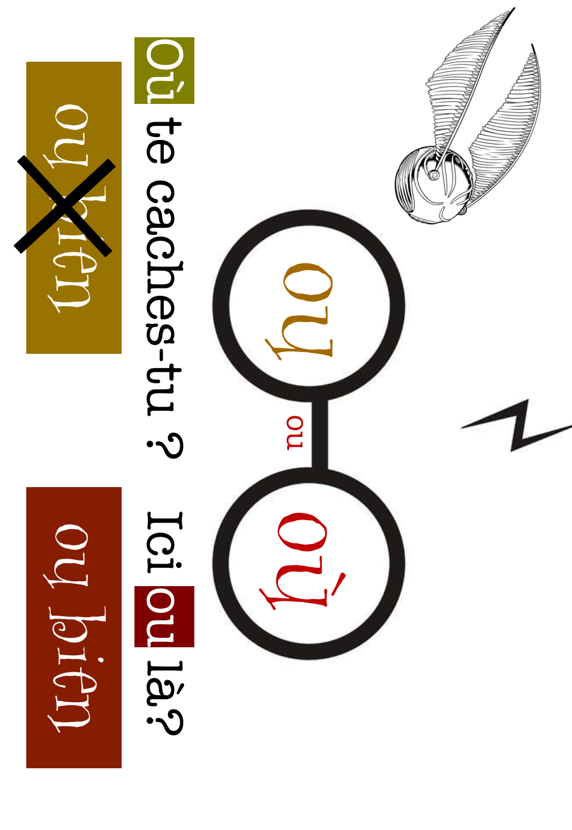






Slide 5
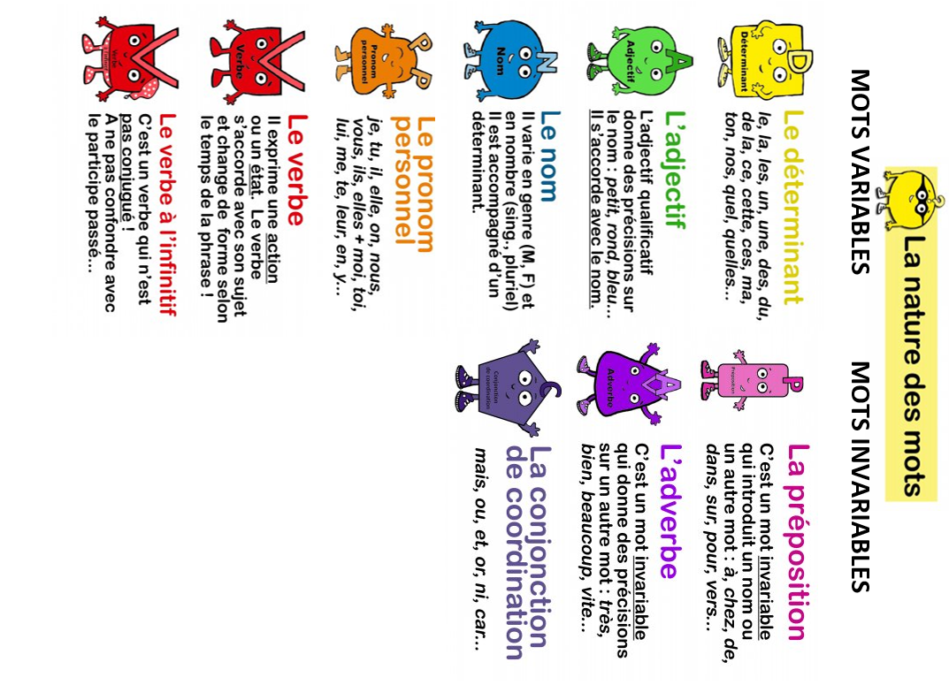
https://creeretcooperer.blogspot.com/2017/09/les-natures-des-mots.html

Slide 6
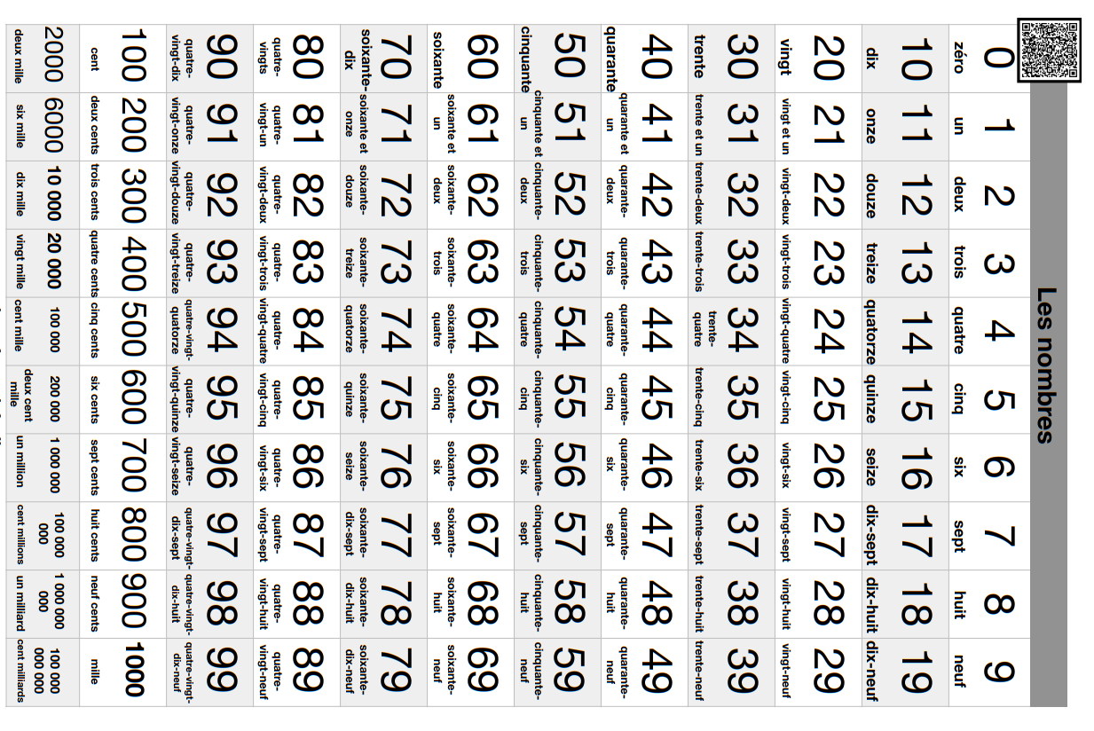

https://linstantenfantin.com/wp-content/uploads/2020/04/sous-main-maths-CM2-1.pdf

Slide 7
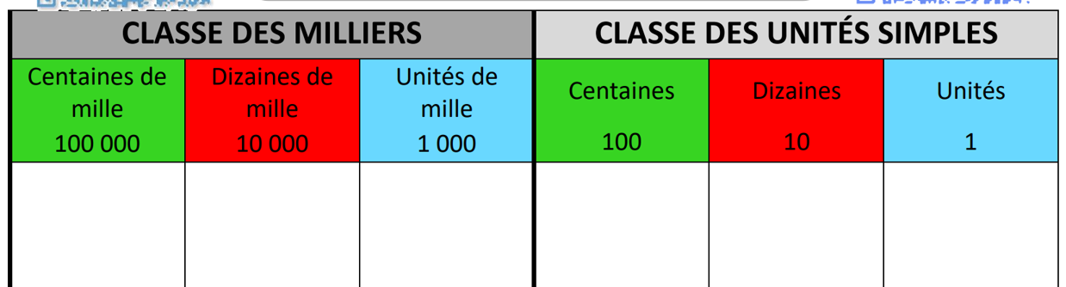
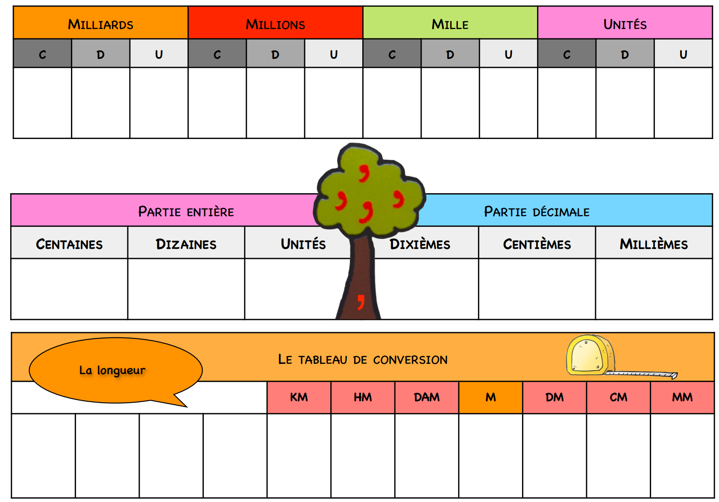
https://linstantenfantin.com/wp-content/uploads/2020/04/sous-main-maths-CM2-1.pdf

Slide 8
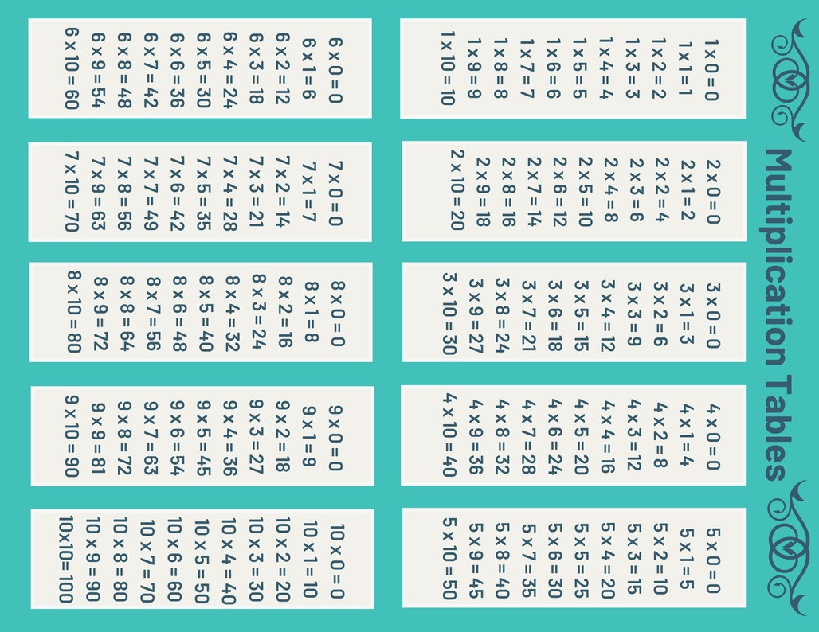

Slide 9
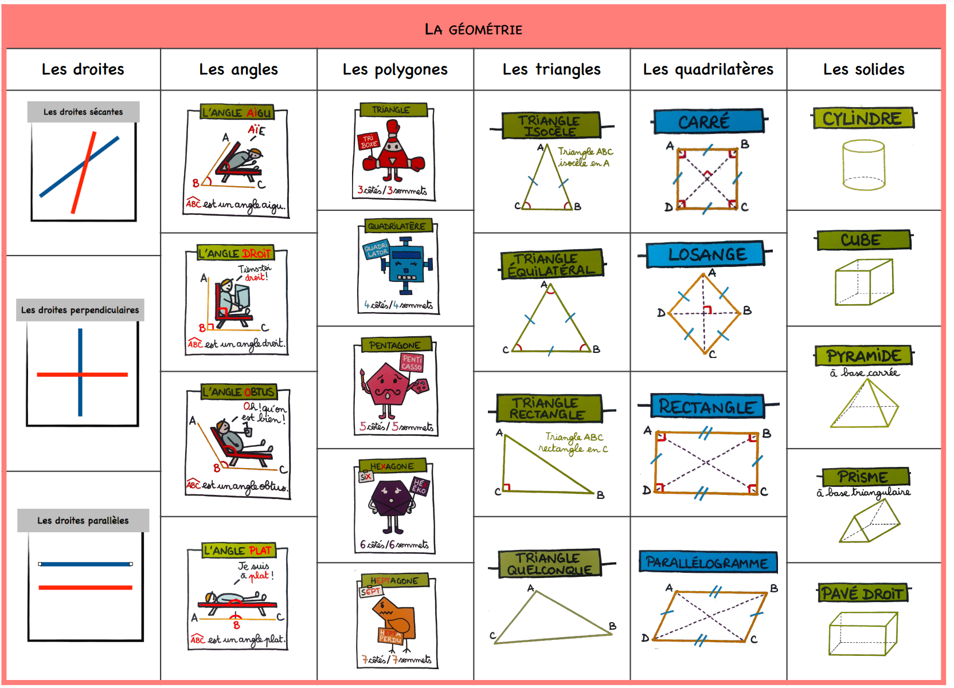
https://linstantenfantin.com/wp-content/uploads/2020/04/sous-main-maths-CM2-1.pdf

Slide 10
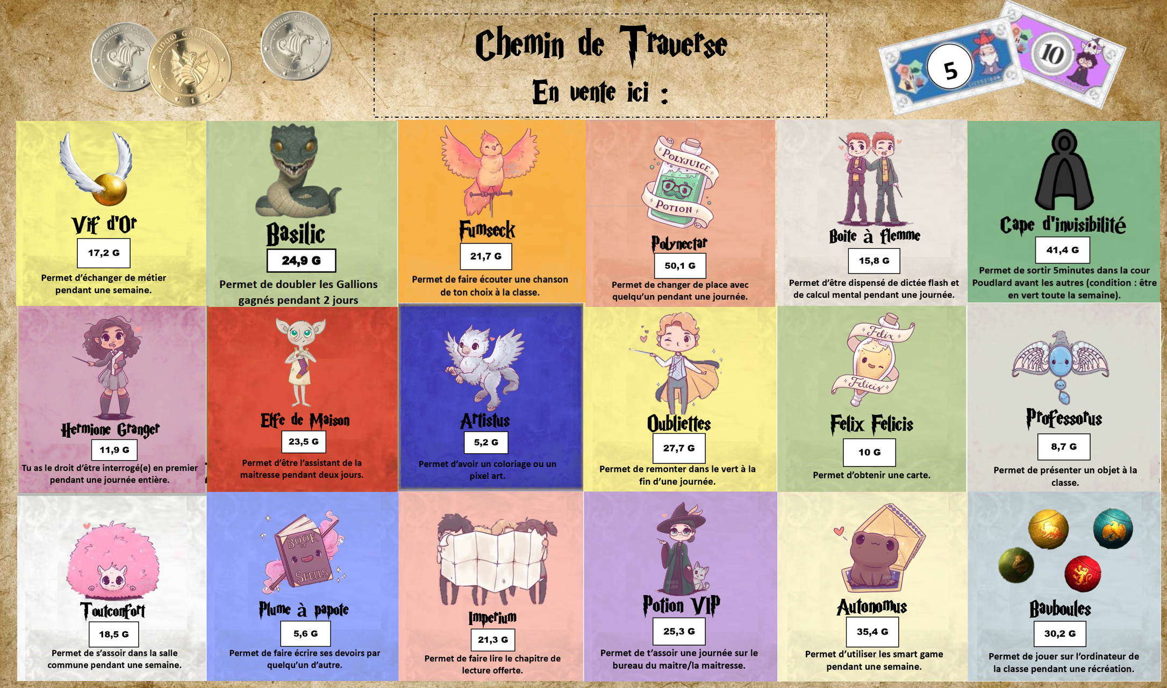
1 gallion = 10 Mornilles
https://latroussebleue.com

